Slide 1
PRESENTATION ON
FOOD WASTE MANAGEMENT SYSTEM DESIGN

Slide 2
AGENDA
Introduction​
Objectives
Database design
​Implementation
​Usage Scenarios
Conclude

Slide 3
Introduction
Food waste is a significant problem globally, with up to one-third of all food produced being wasted each year. This waste has a significant impact on the environment, contributing to greenhouse gas emissions and other environmental issues. To address this problem, a food waste management system can be developed to connect restaurants with charity organizations and other users who can make use of excess food.

Slide 4
Objective
The objective of a database in a food waste management system is to store and manage data related to the management of food waste. This Data may include the following
Type and quantities of food waste
The sources of the waste
The methods used to collect and dispose of the waste

Slide 5
Database design
Database design refers to the process of creating a structured and efficient database that meets the specific needs of an organization or business. The key steps involved in database design include
Identifying the data to be stored : Determine what data needs to be stored, which include the type and their relationship
Defining the data model: The data model is the blue print and defines how the data will be organized and structured
Normalizing the data: It is the process of organizing the data in a way that minimizes and data redundancy and improves data integrity
Creating the database schema: The database schema is the blueprint for how the data will be stored in database, which includes table, columns, types and constrains.

Slide 6
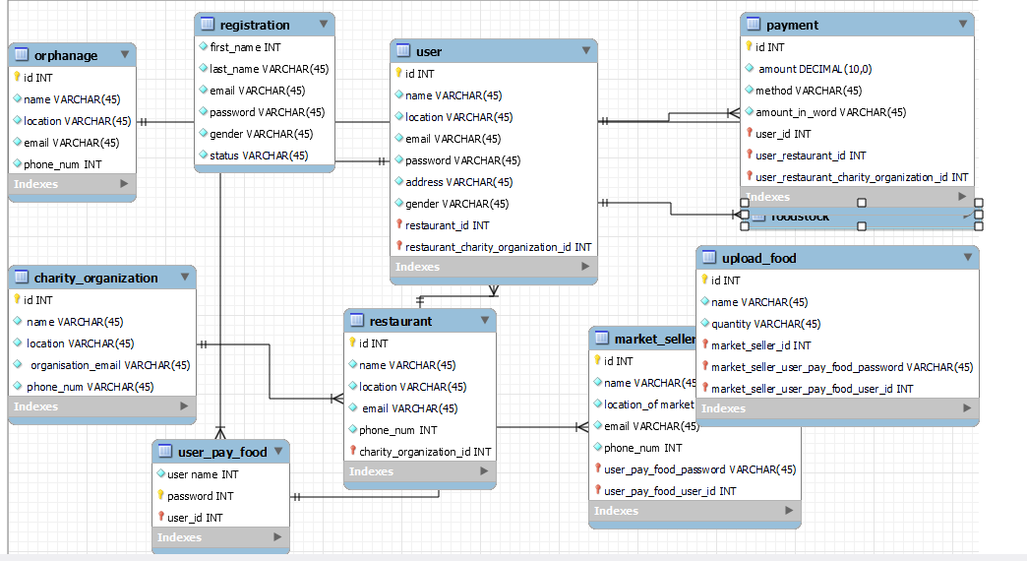
- -
Fig 1. Entity-relationship diagram (ERD):

Slide 7
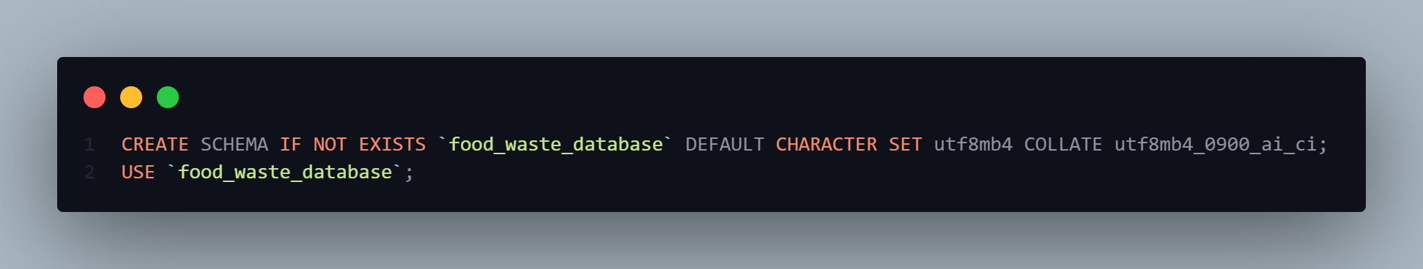
Implementation
The food waste management system can be developed using a variety of software and tools, including a database management system such as MySQL, and a programming language such as PHP, JavaScript, Python and Java. We agree to develop our database implementation using MySQL, the next slide shows the various queries to create our database tables : Charity, User, Restaurant, and food stock
Fig 2. SQL query to create a schema and select DB

Slide 8
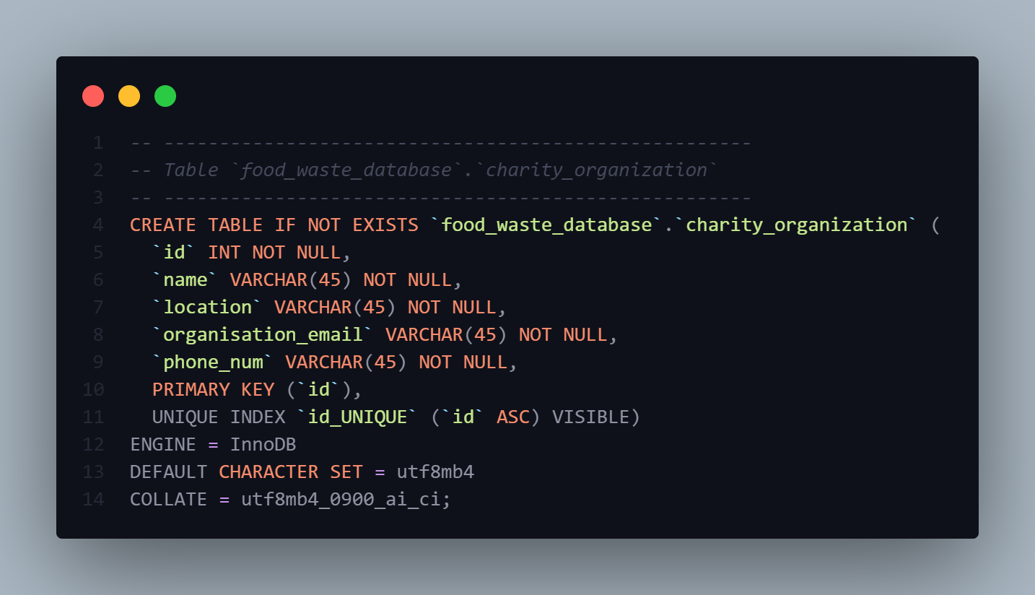
Fig 3. SQL query to create a charity table

Slide 9
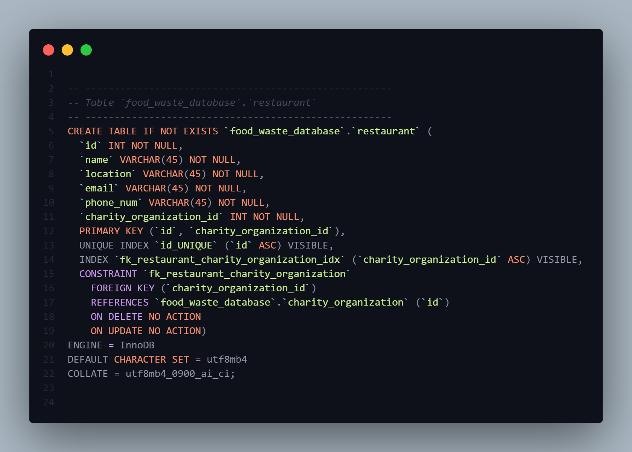
Fig 4. SQL query to create a table restaurant

Slide 10
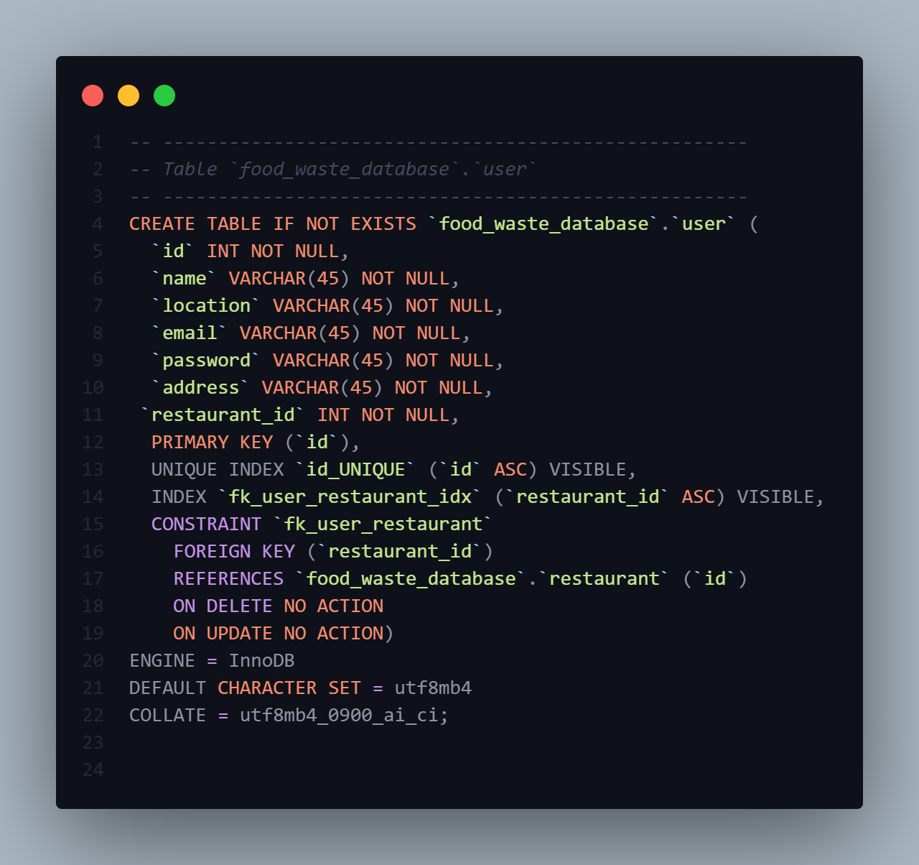
Fig 5. SQL query to create a table User

Slide 11
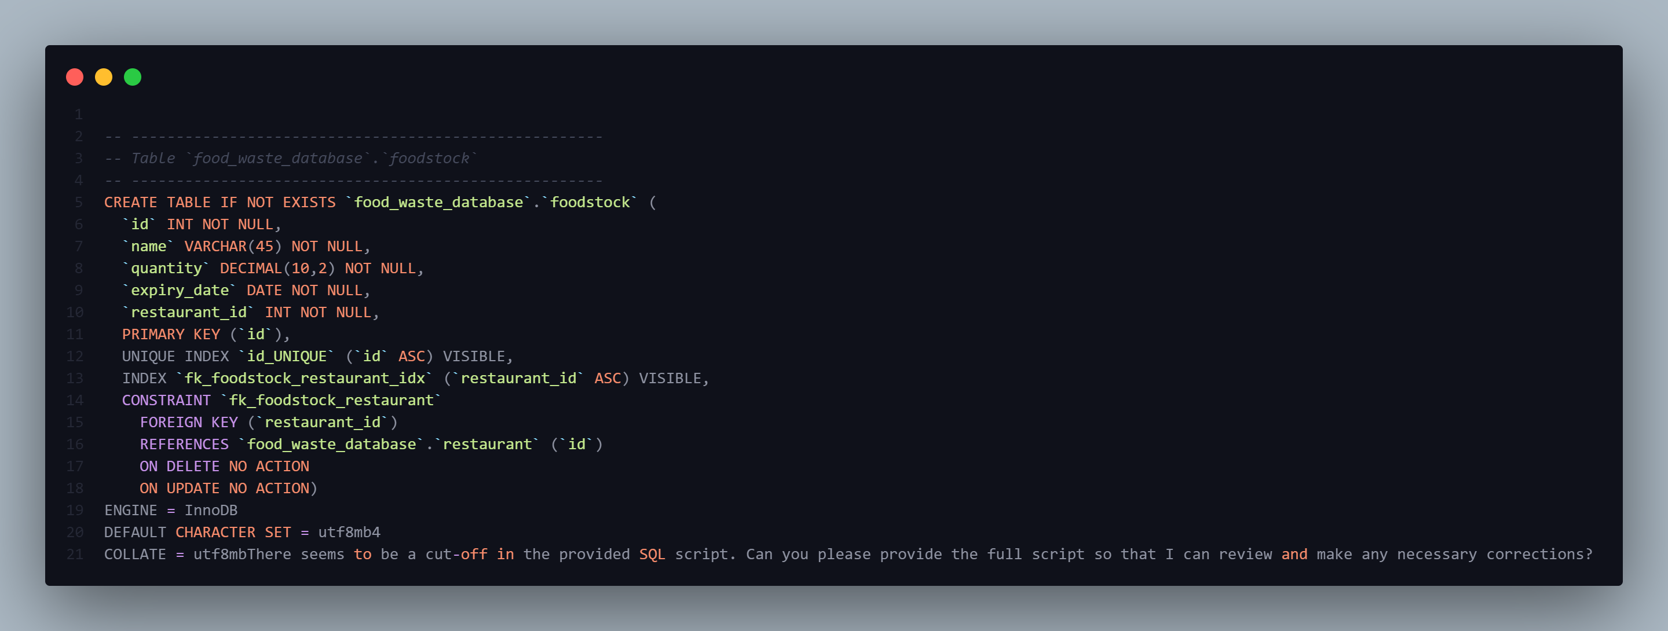
Fig 5. SQL query to create a table food stock

Slide 12
Usage scenarios - -
Use cases for the database, including queries and reports. The food waste management system can be used for a variety of purposes, including:
Tracking food inventory and expiration dates
Identifying excess food and connecting restaurants with charity organizations and other users who can make use of the food
Generating reports on food waste reduction and sustainability
Facilitating the transfer of excess food from restaurants to charity organizations Examples of how the database can be used to reduce food waste and promote sustainability:
A restaurant can use the system to track food inventory and expiration dates, reducing the likelihood of food waste due to spoilage.
A charity organization can use the system to identify restaurants with excess food and connect with them to receive the food, reducing food waste and providing food to those in need.
Users can use the system to generate reports on food waste reduction and sustainability, providing insight into how the system is making a positive impact on the environment.

Slide 13
Conclusion
Summary of the database design and implementation:
The food waste management system is designed to reduce food waste by allowing restaurants to identify excess food and connect with charity organizations and other users who can make use of the food. The system includes tables for restaurants, charity organizations, users, food stock, and payments, and is implemented using a MySQL database management system and a programming language such as PHP or Python. The tables are linked through relationships that allow for tracking of food inventory and expiration dates, generating reports on food waste reduction and sustainability, and facilitating the transfer of excess food from restaurants to charity organizations.

Slide 14
Conclusion
Overall assessment of the potential impact of the database:
The food waste management system has the potential to make a significant impact on reducing food waste and promoting sustainability by connecting restaurants market sellers with charity organizations and other users who can make use of excess food. The system's ability to track food inventory and expiration dates, generate reports on food waste reduction and sustainability, and facilitate the transfer of excess food make it a valuable tool in promoting sustainable food practices.

Slide 15
THANK YOU
for your attention

